Slide 1
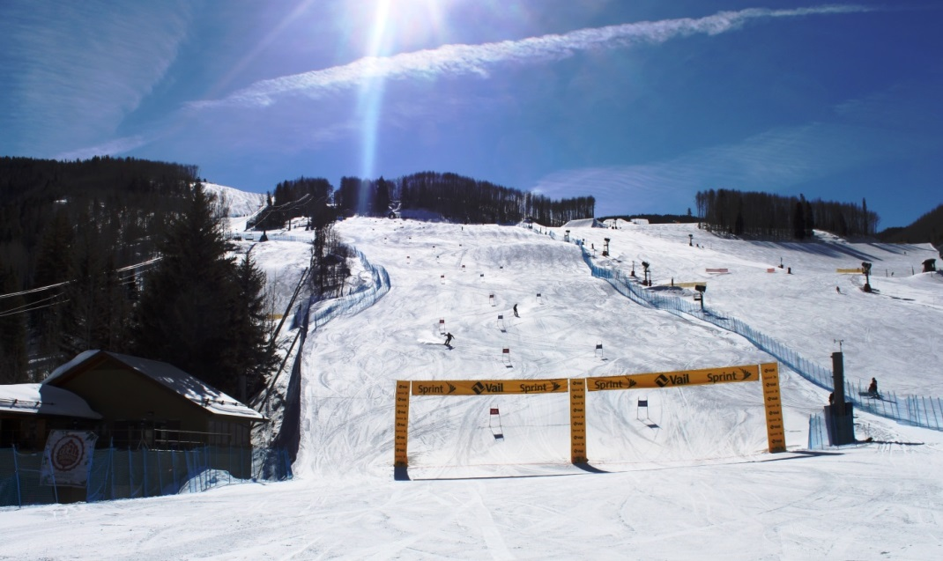
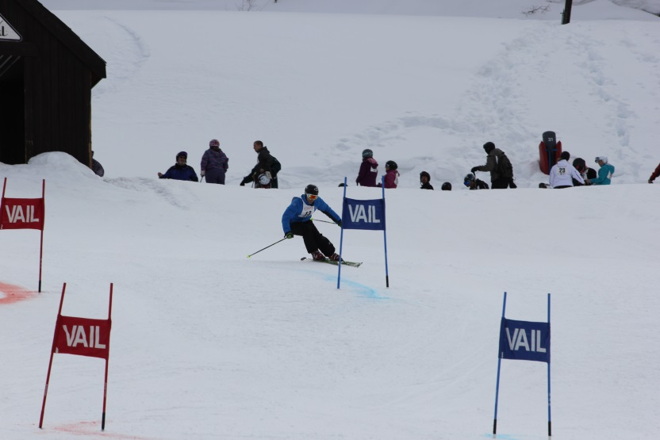
44th Annual Colorado Peace Officers Ski & Snowboard Race Vail, Colorado March 10, 2017
Entry fee:
$75.00 by February 24th
$90.00 on/after February 25th, 2017.
Make checks payable to “Town of Vail” and place “Vail Police Ski Race” in the memo line. Checks or cash only please.
Entry Fee includes:
Vail Mountain lift ticket good for race day skiing or snowboarding.
Continental breakfast, two professionally timed runs at Golden Peak, awards after party and free parking.
Divisions:
Men and women
Individual or teams divided into beginners, intermediate and advanced levels.
Race is open to all sworn and non-sworn Police Department personnel including retired Law Enforcement.
» To register, visit www.vailgov.com/police
and download the 2014 Ski Race Form
For questions, please contact:
Vail Police Officer Greg Schwartz at gschwartz@vailgov.com

